Slide 1
Chrome based Keyword Visualizer (under sparse text constraint)
Computer science 2013210085 sangho suh
Industrial engineering 2010170835 moonshik kang
Computer science 2010210012 hoonhee cho
12/7/2015
Notes:
제목찾기
많은 사람들이 정보의 홍수속에서 빠르고 정확하게 컨텐츠의 주제나 키워드를 알고 싶어한다.
우리는 정보검색에서 중요한 이슈중에 하나인 글의 ‘키워드를 찾는’ 것에 집중해 보았다.

Slide 2
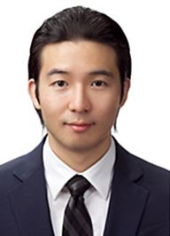

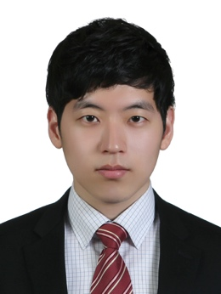
Team
Sangho Suh
Hunhee Cho
Moonshik Kang

Slide 3
INDEX
Proposal Recap
Implementation
Evaluation
Future Works

Slide 4
Proposal Recap

Slide 5
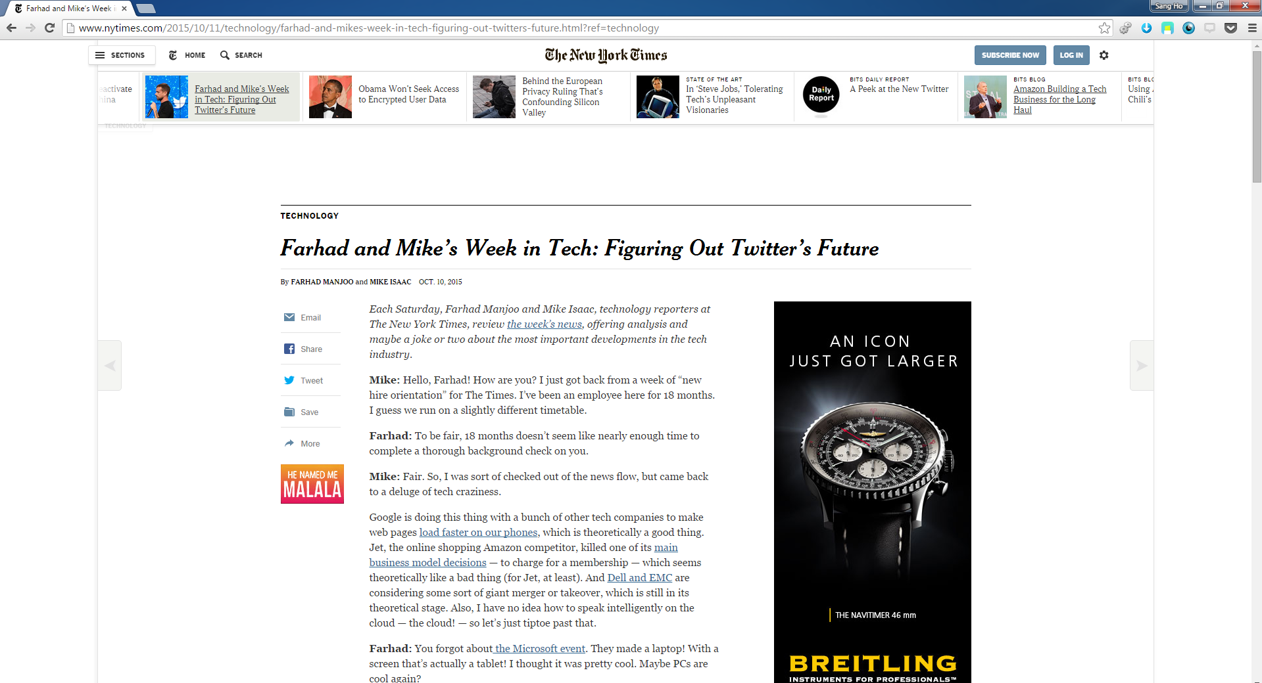
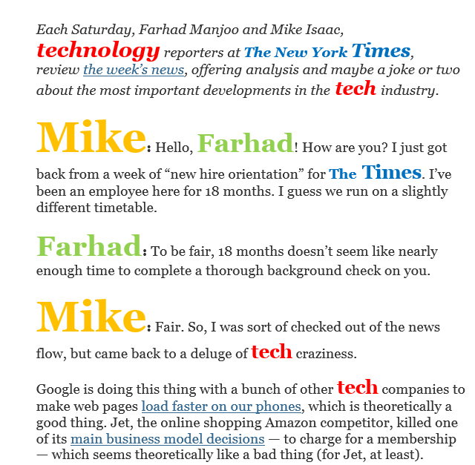

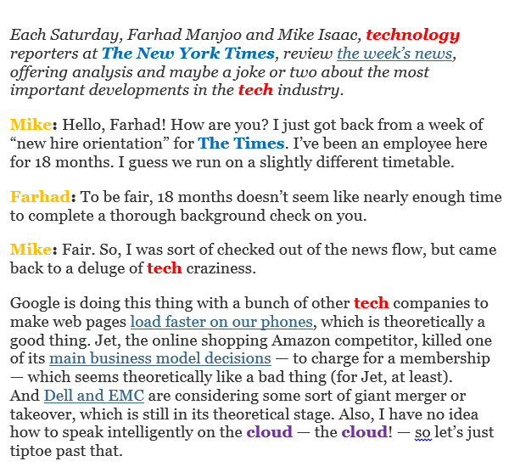
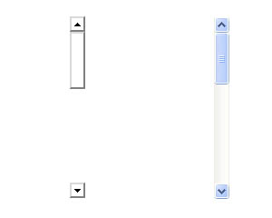


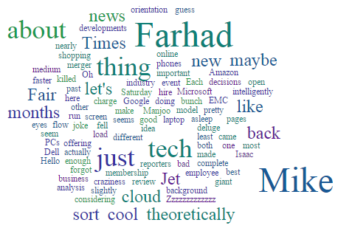

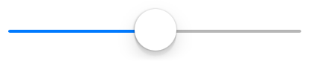
Keyword Visualizer (chrome plugin)
Click!
TF weighting
TF-IDF weighting
subject indexing
RUN
Click!
Notes:
Imaginational Simulation (not real)
위에 제시된 알고는 예시 -> 다른 것들 추가 예정

Slide 6
Implementation

Slide 7
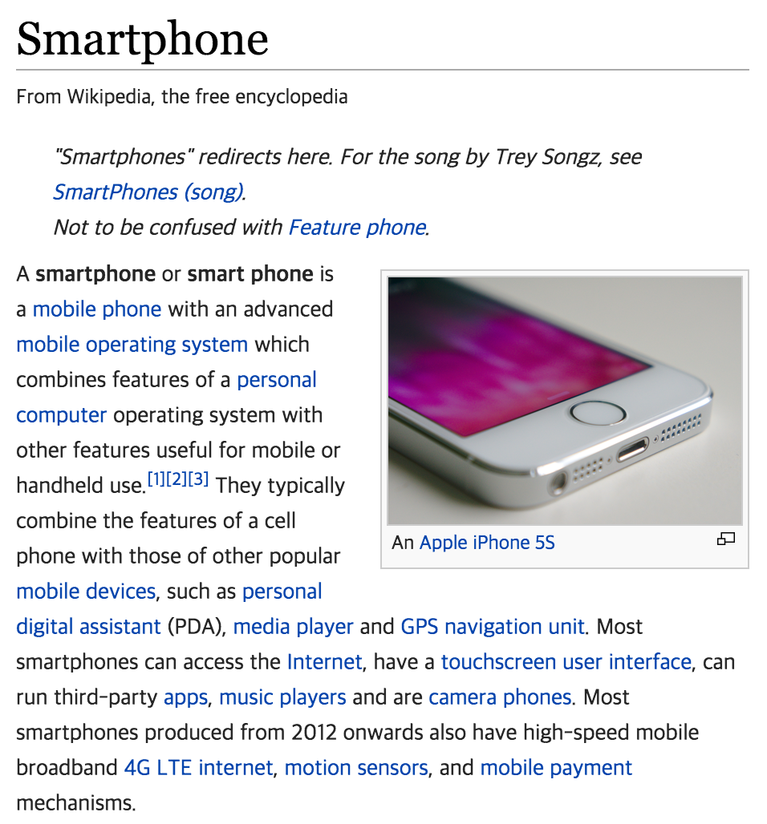
Architecture
Keyword Visualizer
Web crawler
Bag-of-word
generator
Visualizer

Slide 8
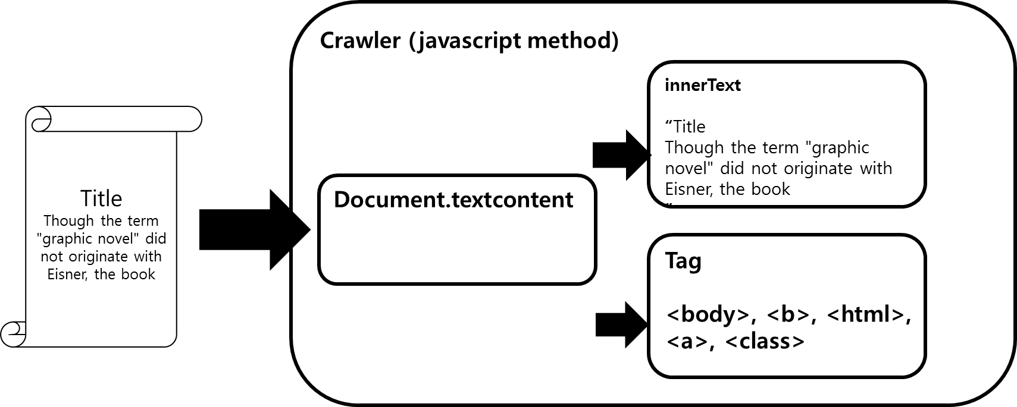
Architecture

Slide 9
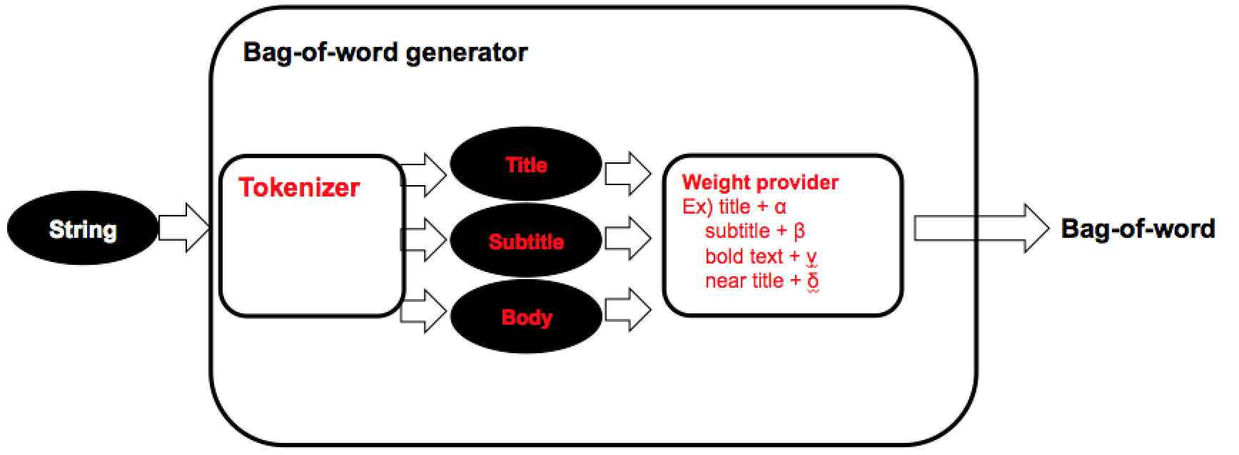
Architecture

Slide 10
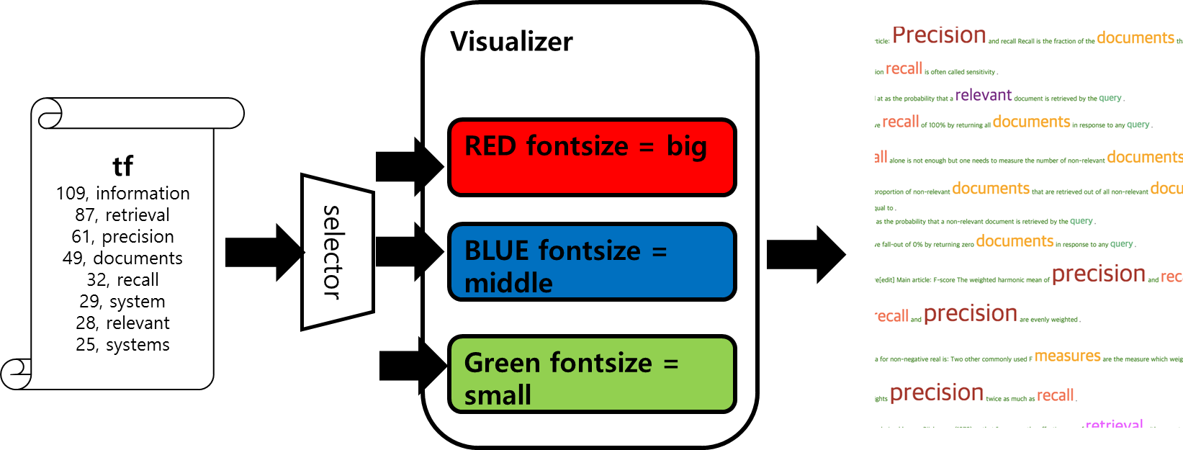
Architecture

Slide 11
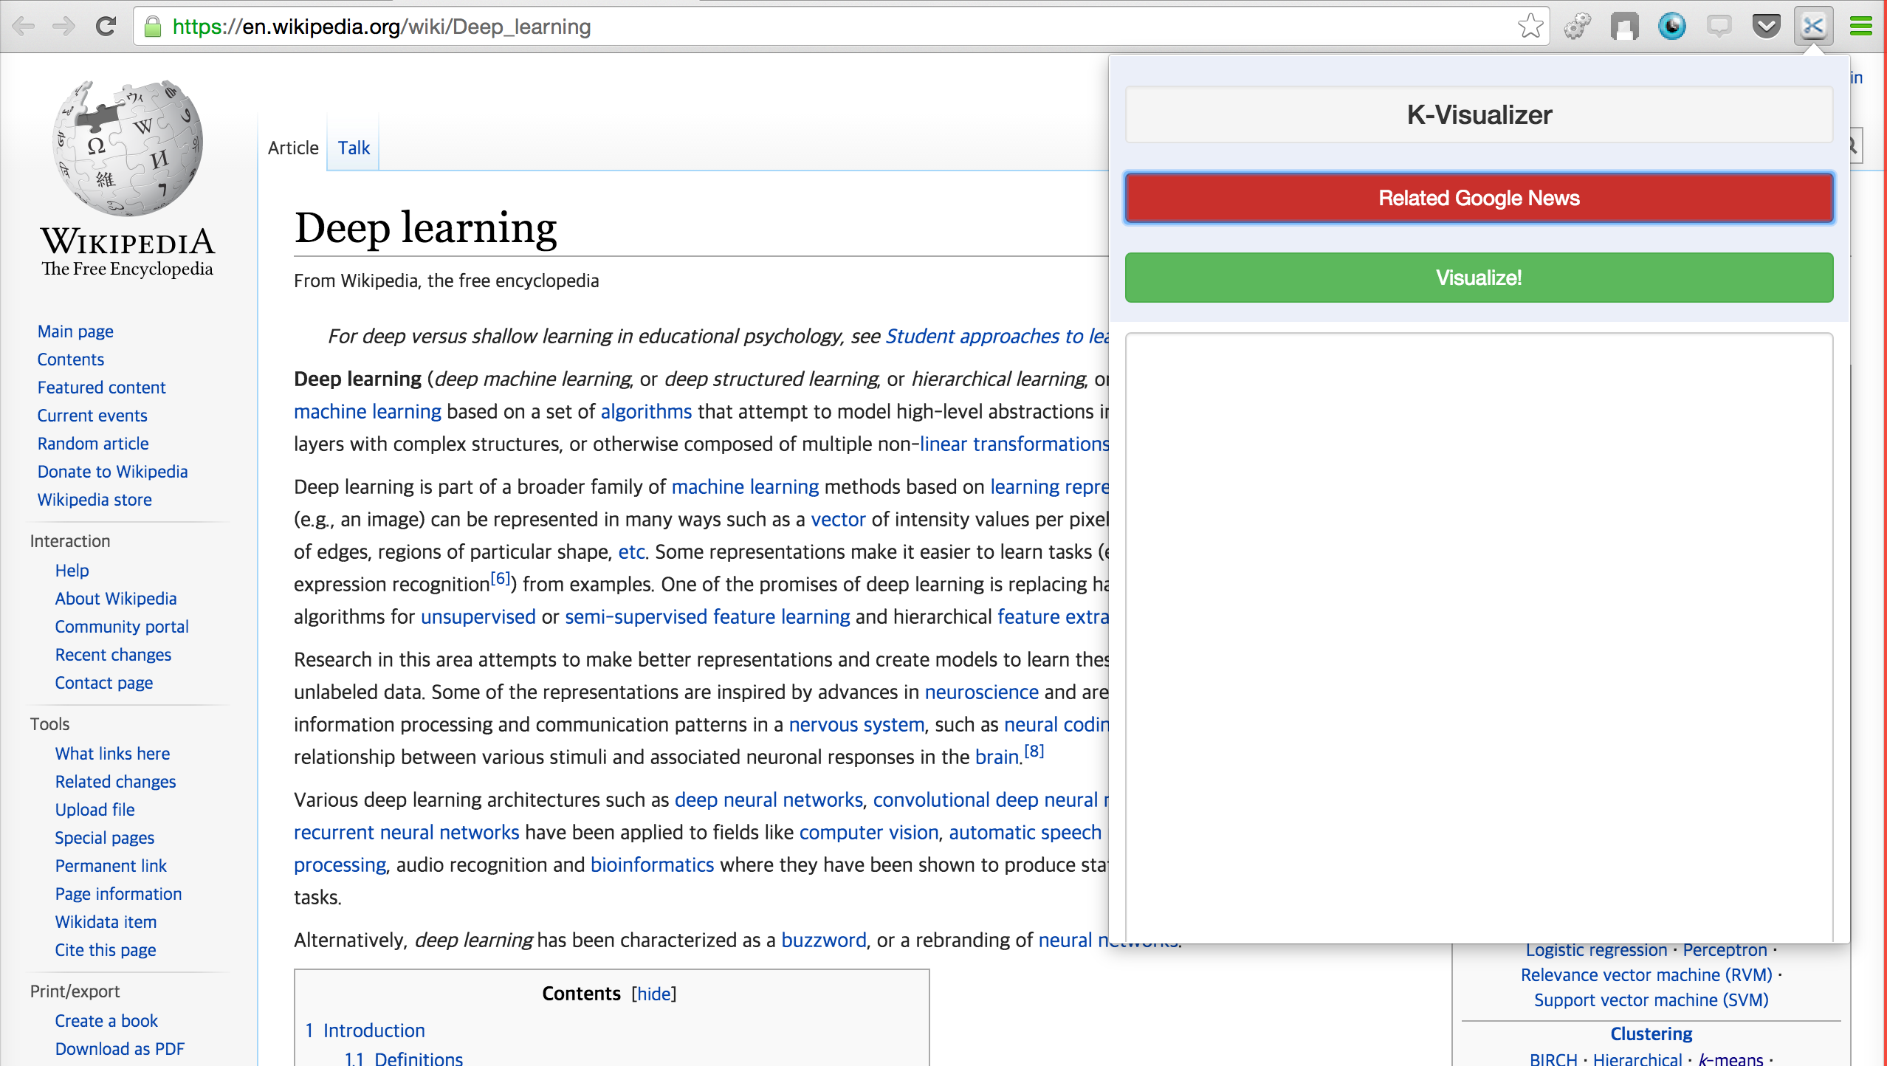
Chrome Plugin

Slide 12
How?
There are many keyword extraction techniques..

Slide 13
How?
Such as..
1. Word Frequency Analysis
2. Word Co-Occurrence Relationships
3. Frequency-Based Single Document Keyword Extraction
4. Content-Sensitive Single Document Keyword Extraction
5. Keyword Extraction Using Lexical Chains
6. Keyphrase Extraction Using Bayes Classifier

Slide 14
How?
We can use..
1. Word Frequency Analysis
2. Word Co-Occurrence Relationships
3. Frequency-Based Single Document Keyword Extraction
4. Content-Sensitive Single Document Keyword Extraction
5. Keyword Extraction Using Lexical Chains
6. Keyphrase Extraction Using Bayes Classifier

Slide 15
How?
Because ..
1. Web-based
2. Single-document

Slide 16
Word Frequency Analysis
1) Clean the text
(Remove punctuations and stop words)
2) Tokenize the text
3) Find the TF (term frequency) for each unique token
4) Sort each token in descending count order

Slide 17
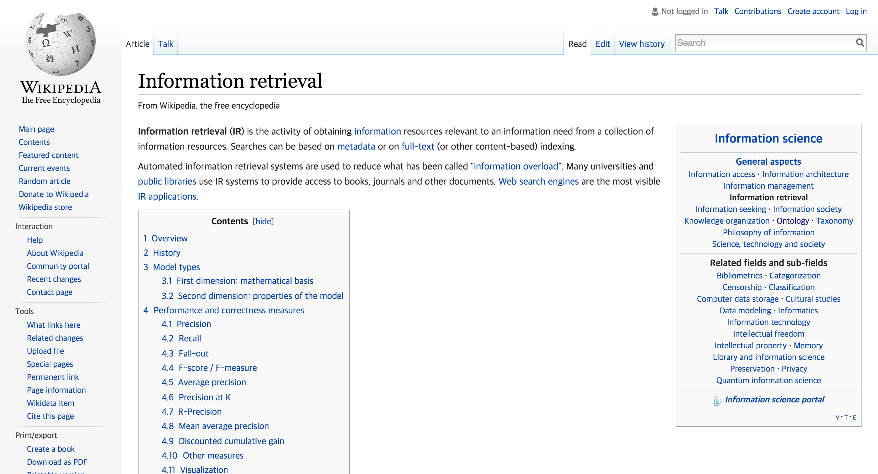
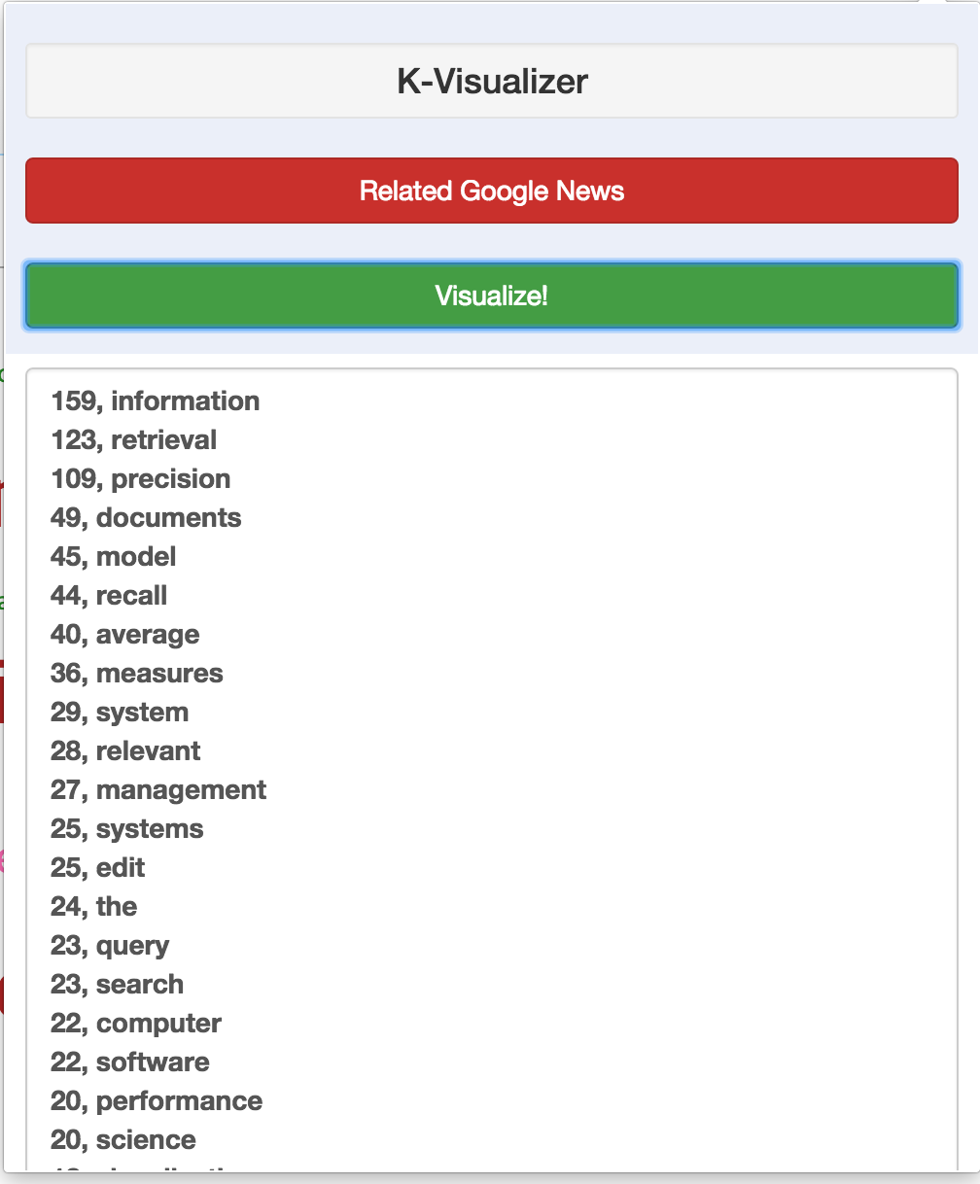
Feature1 - Frequency Weighting
1 appearance = weight 1

Slide 18

Feature2 – Meta Tag Weighting
HTML
<HTML>
<TITLE> </TITLE>
<a href=“”> IR </a>
<b> Prof. Choo </b>
.
.
.

Slide 19
Feature2 – Meta Tag Weighting
+α
<TITLE>
<a>
<b>
+β
+γ

Slide 20
Why Meta Tag Weighting?
Problem
1. Topic Modeling of single page
is under sparse text constraint
2. No viable method exists for
constructing Term-Document Matrix

Slide 21
Why Meta Tag Weighting?
Problem
1. Topic Modeling of single page
is under sparse text constraint
2. No viable method exists for
constructing Term-Document Matrix
Difficult to Extract Keywords

Slide 22
Why Meta Tag Weighting?
Need
- ‘Additional’ or ‘Hidden’ information
Tags can provide additional semantic information

Slide 23
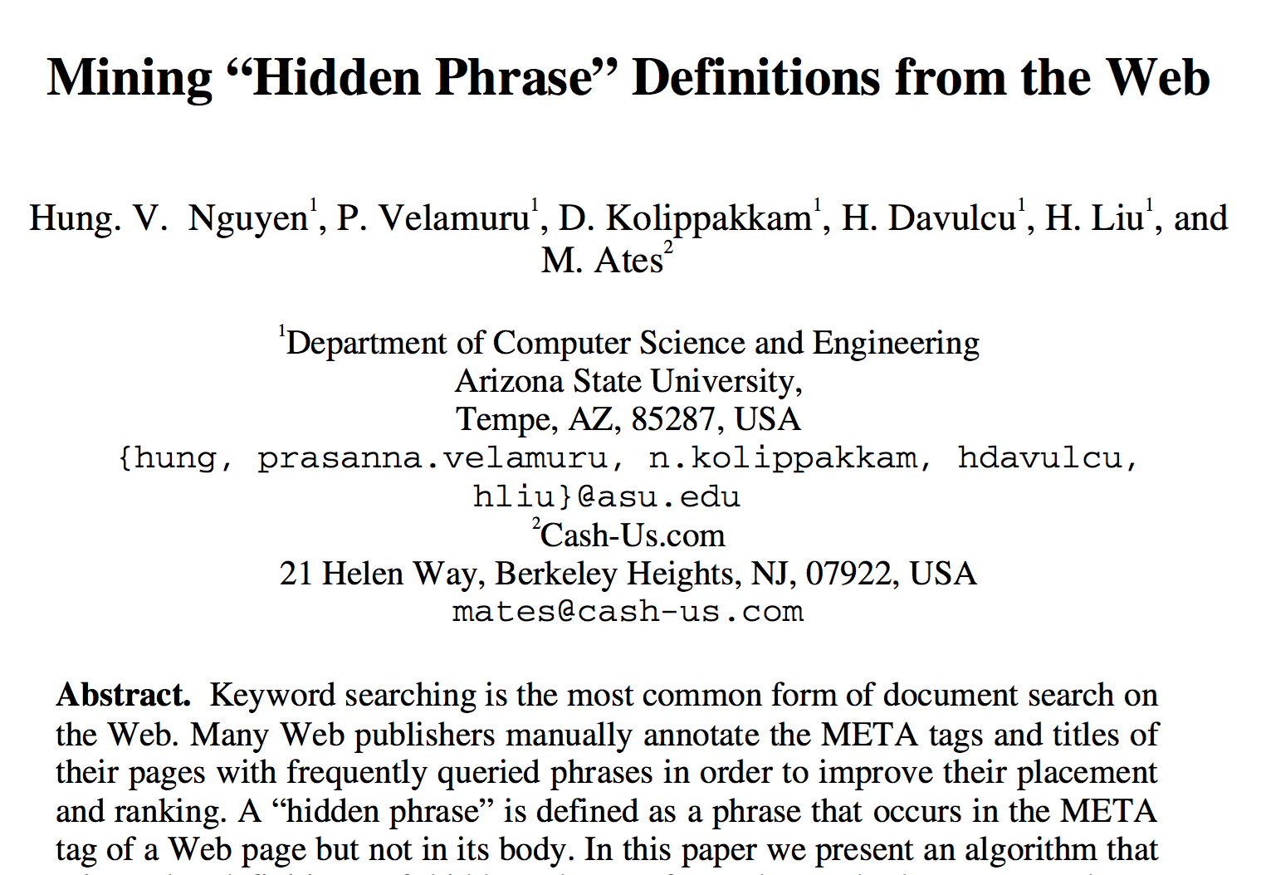
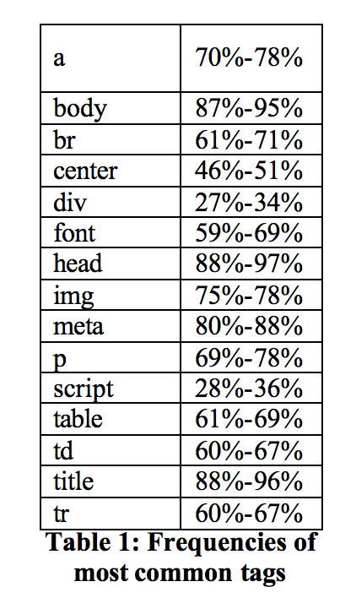
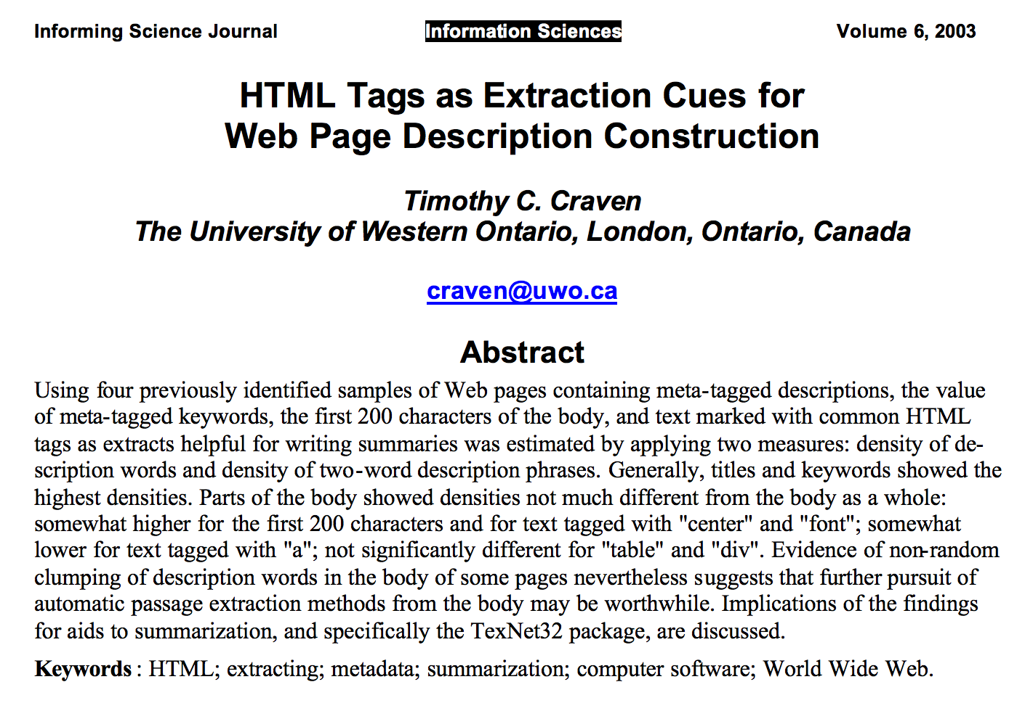
Why Meta Tag Weighting?

Slide 24
Feature3 – Distance Weighting (Feature 1)
Weight on words within ε of <title>,
i.e.
where is distance from
<title> tag

Slide 25
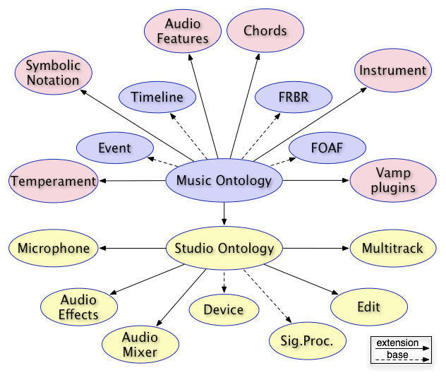
Feature4 – Similarity Weighting
Weight based on ‘Ontology based Similarity score’
1) Extract words from innerText of <title>
2) Measure similarity score of selected
words with words in the text
3) Add weight on the words with
high similarity score

Slide 26
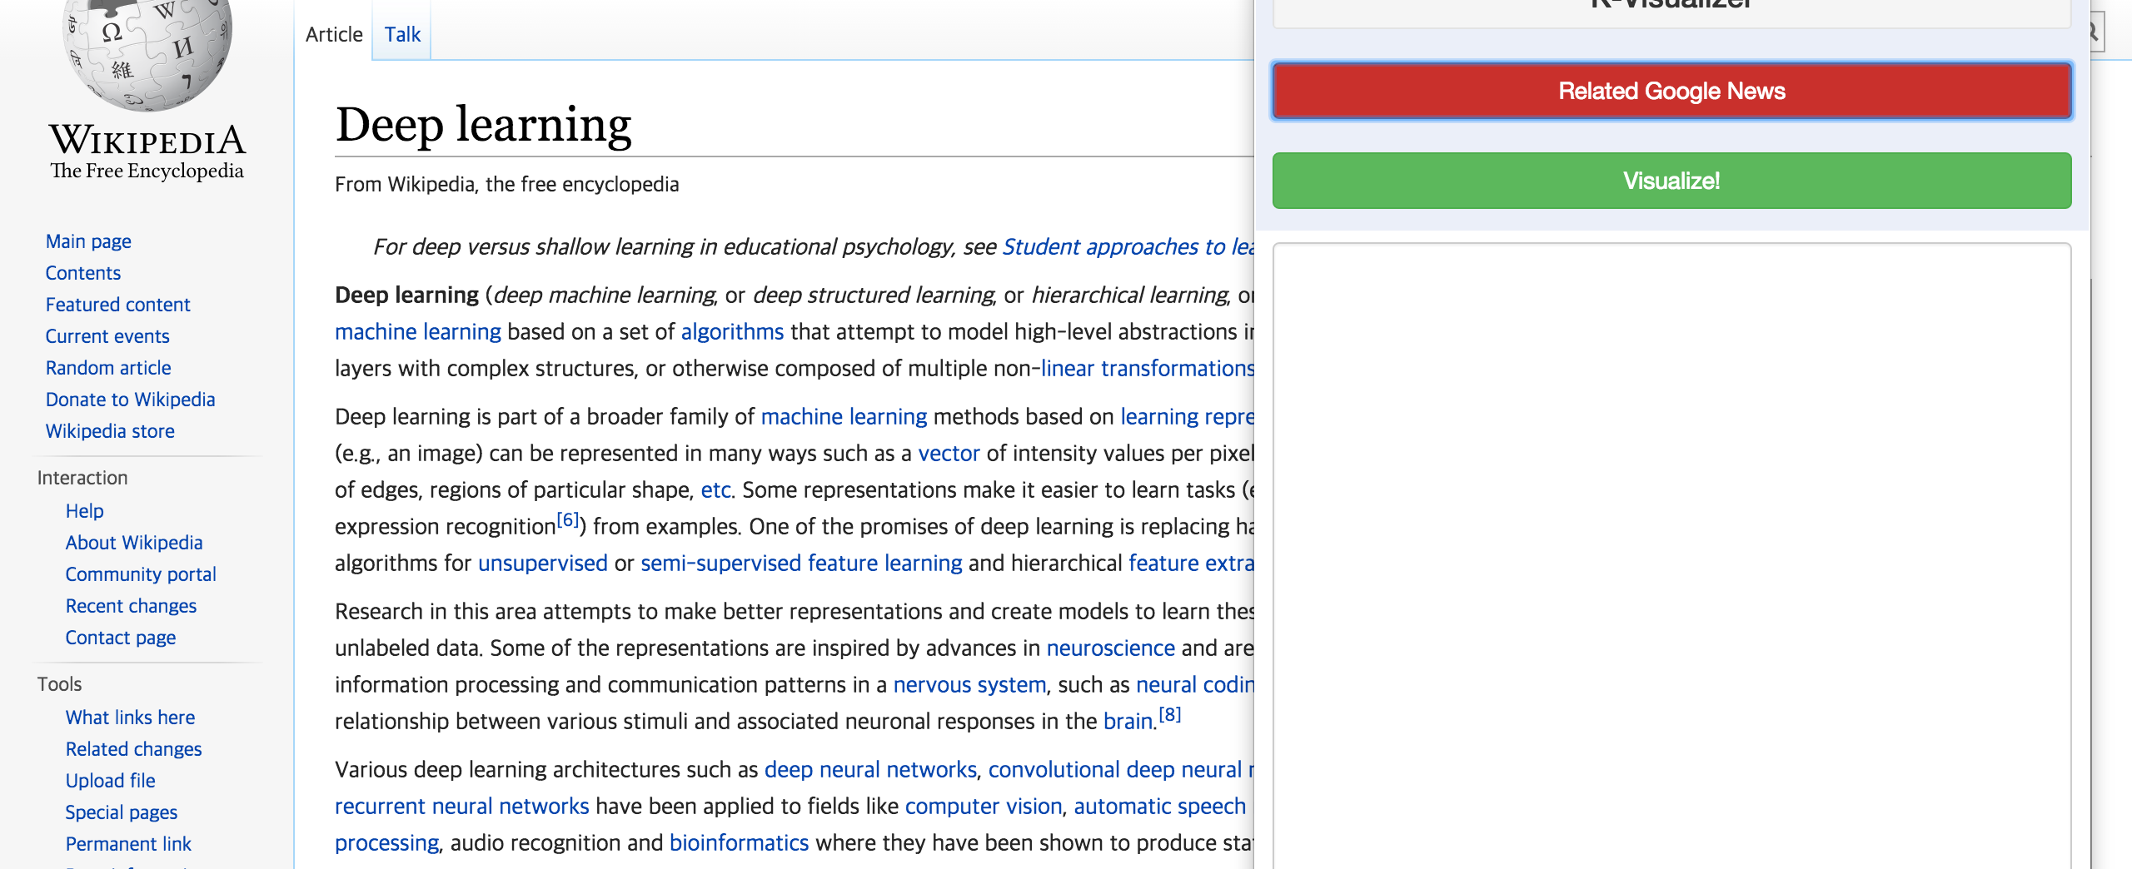
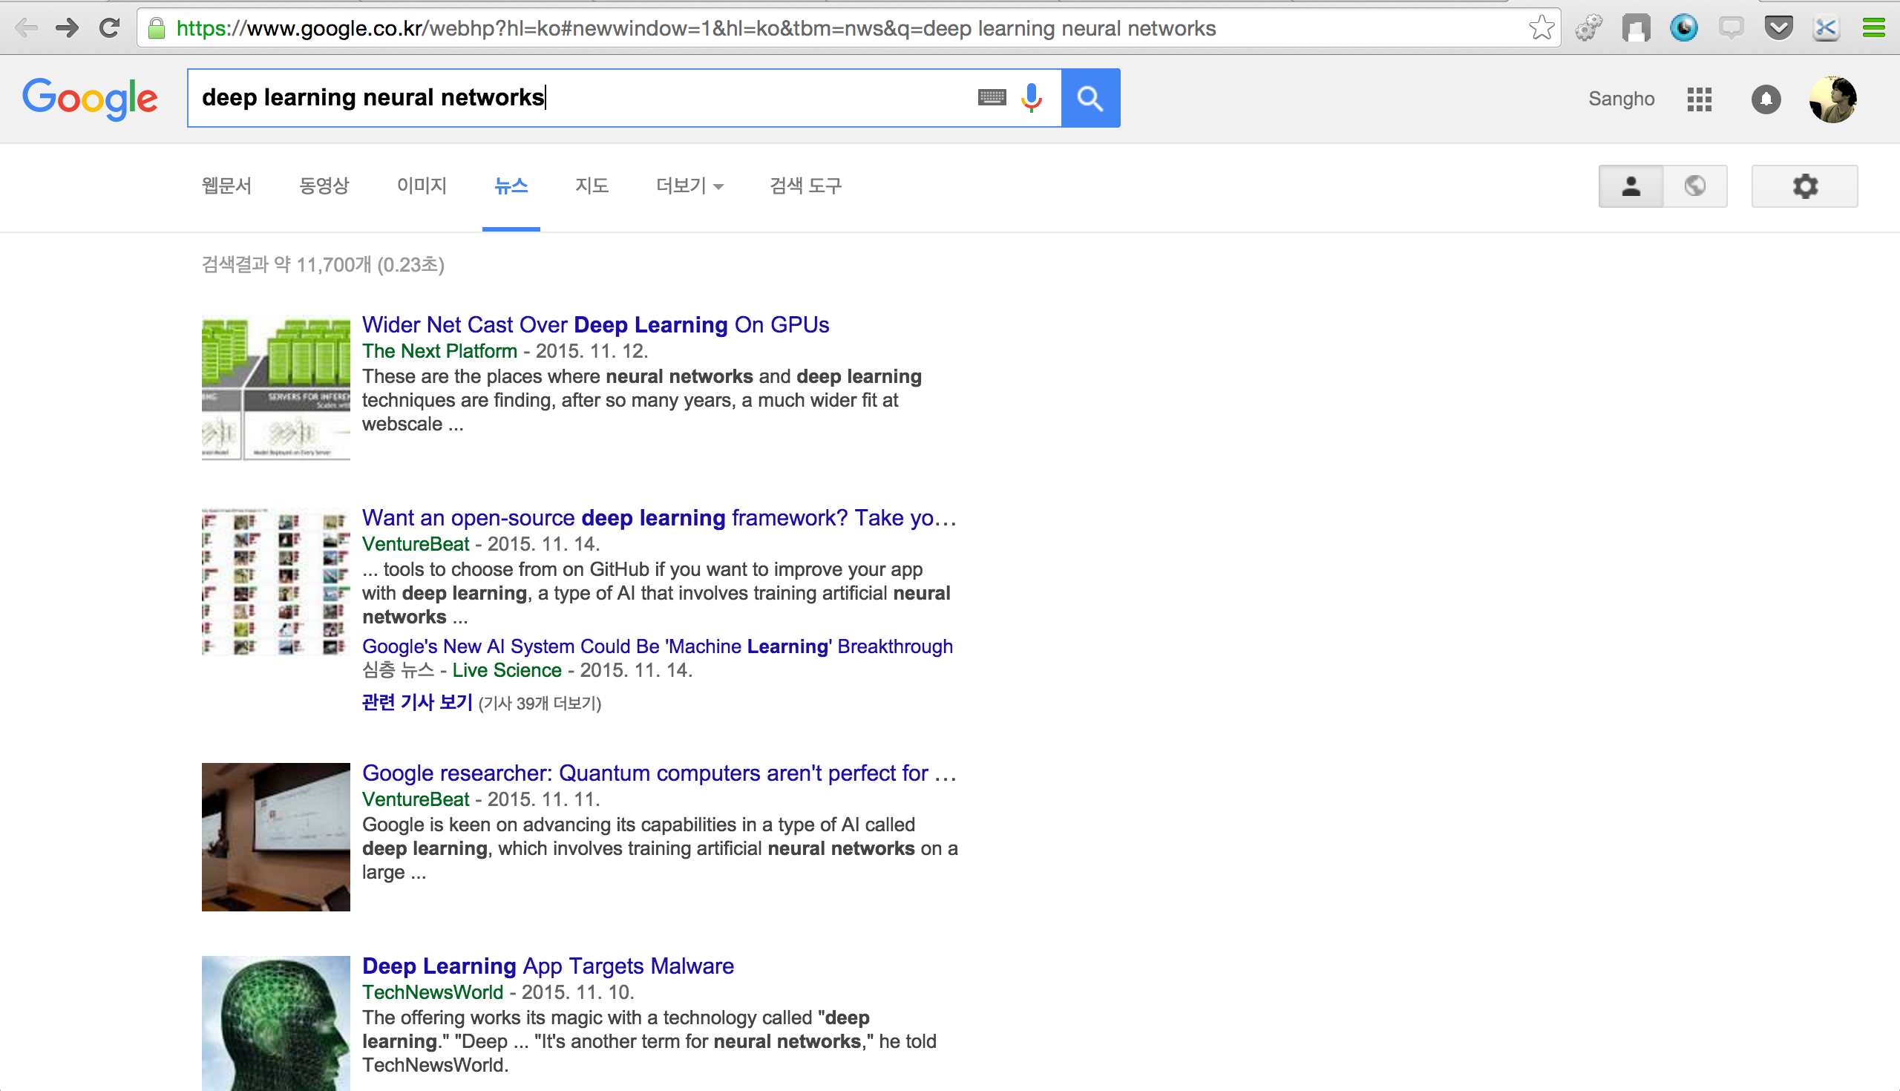
Feature 5 – Google News Recommendation

Slide 27
Evaluation

Slide 28
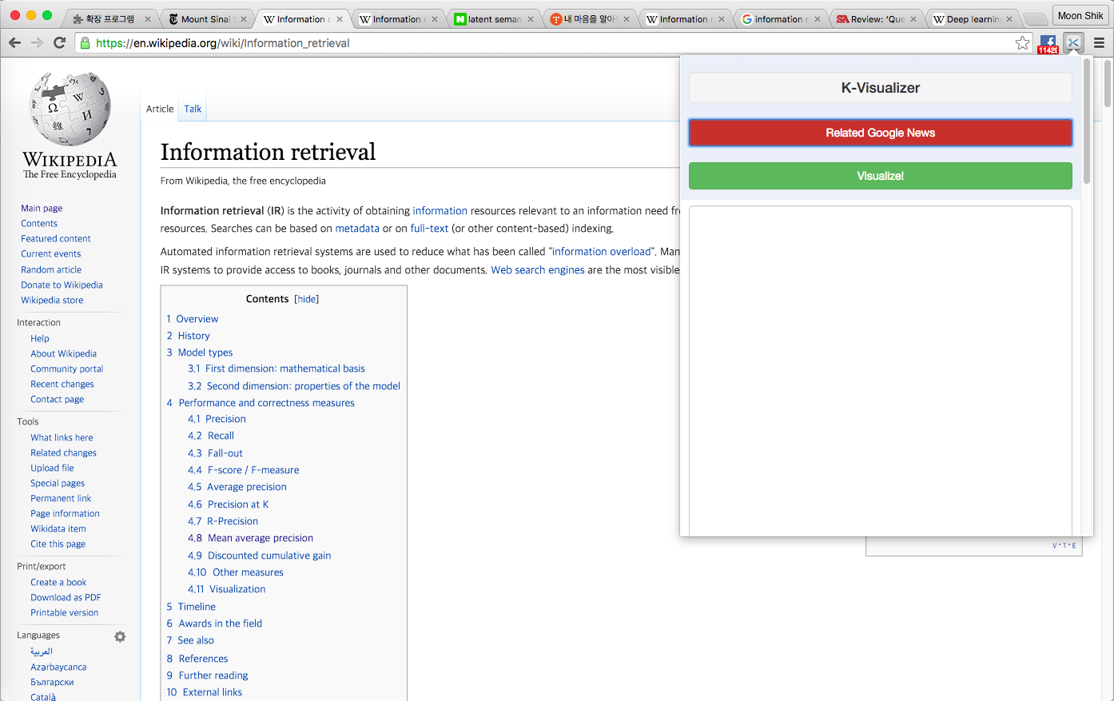
Test K-Visualizer

Slide 29
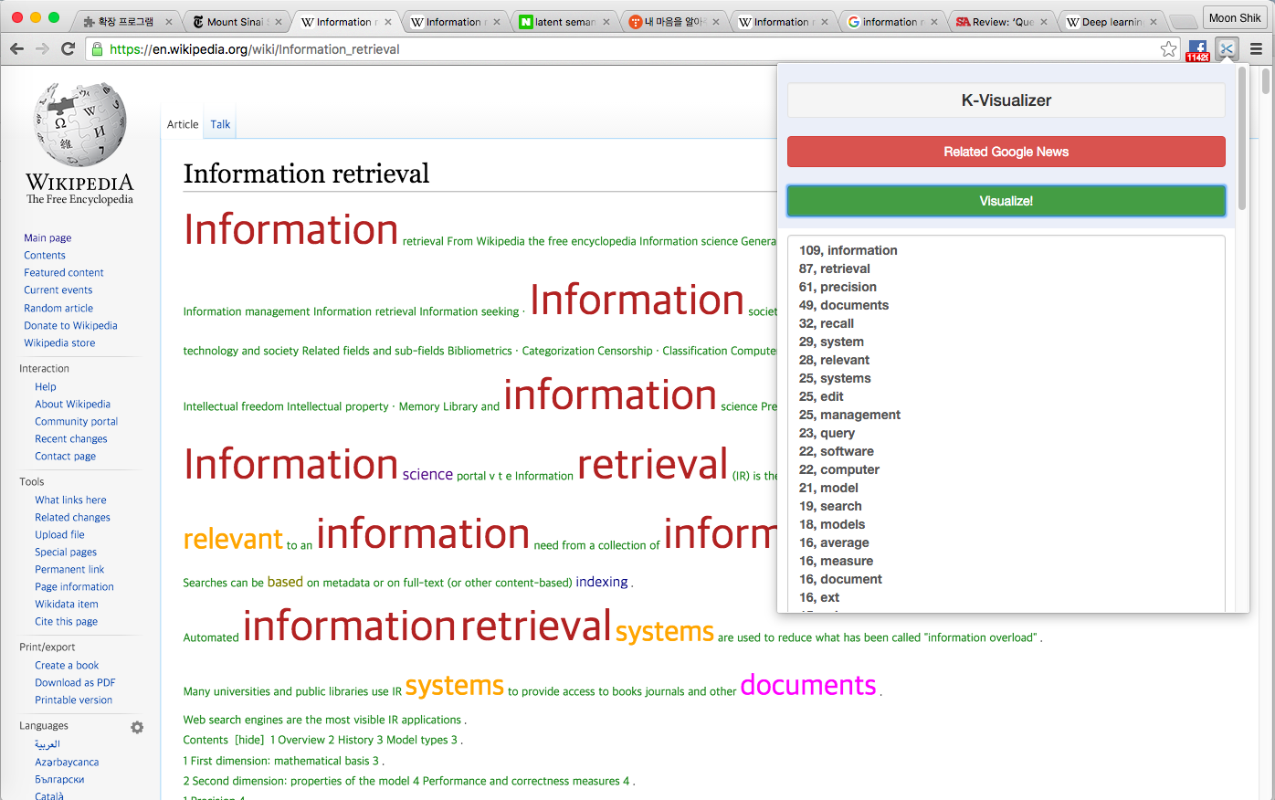
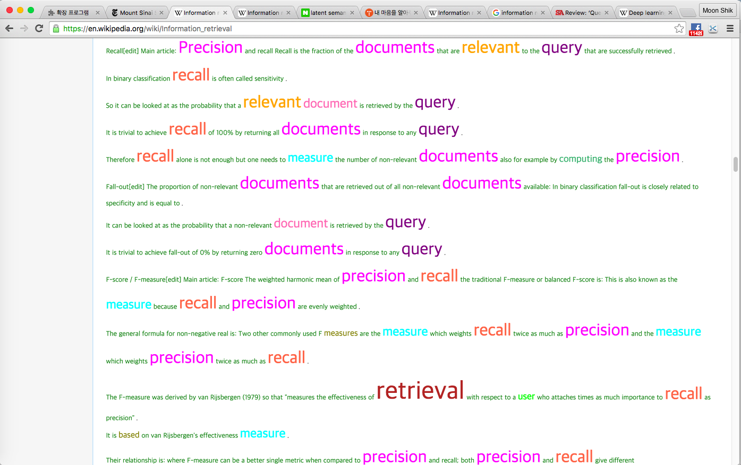
1. Only with term frequency
109, information
87, retrieval
61, precision
49, documents
32, recall
29, system
28, relevant
25, systems
25, edit
25, management
23, query
22, software
22, computer
21, model
19, search
18, models
16, average
16, measure
16, document
16, ext
15, science
15, data
14, published
14, user
14, relevance
14, text
14, analysis
13, network
13, computing
13, evaluation
12, based
12, measures
11, conference
11, score
10, set
10, indexing
10, vector
9, terms
9, rank
9, machine

Slide 30
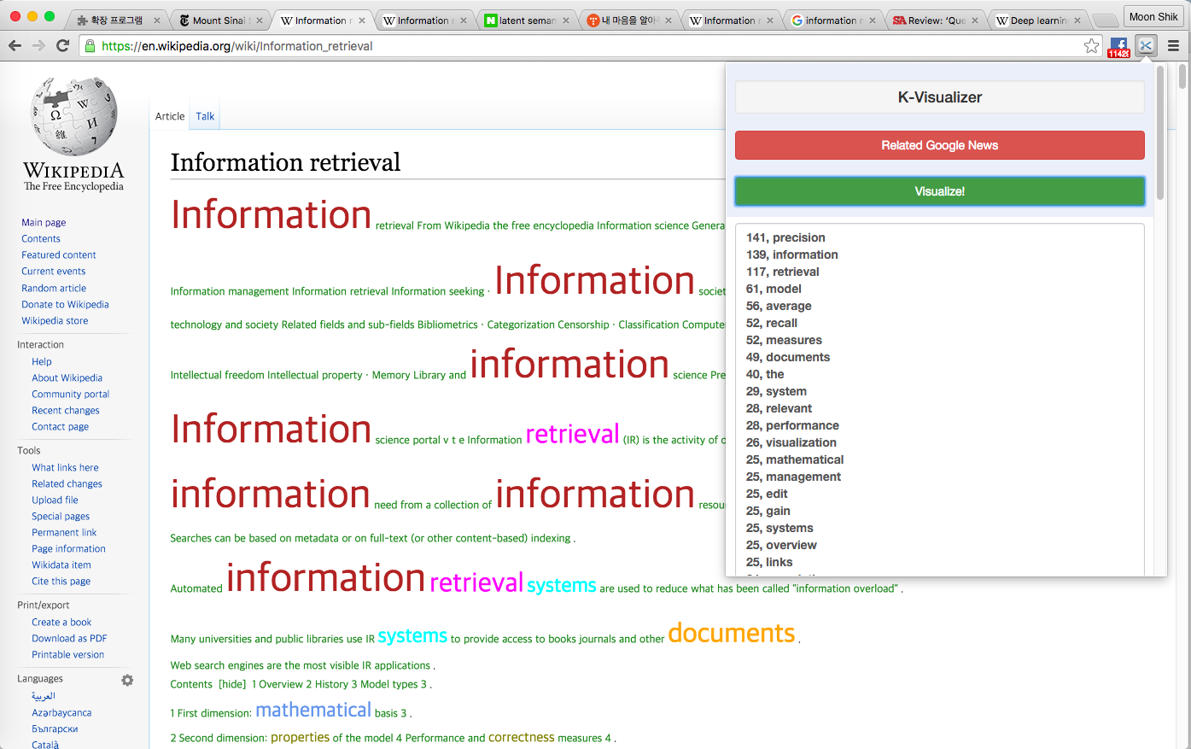
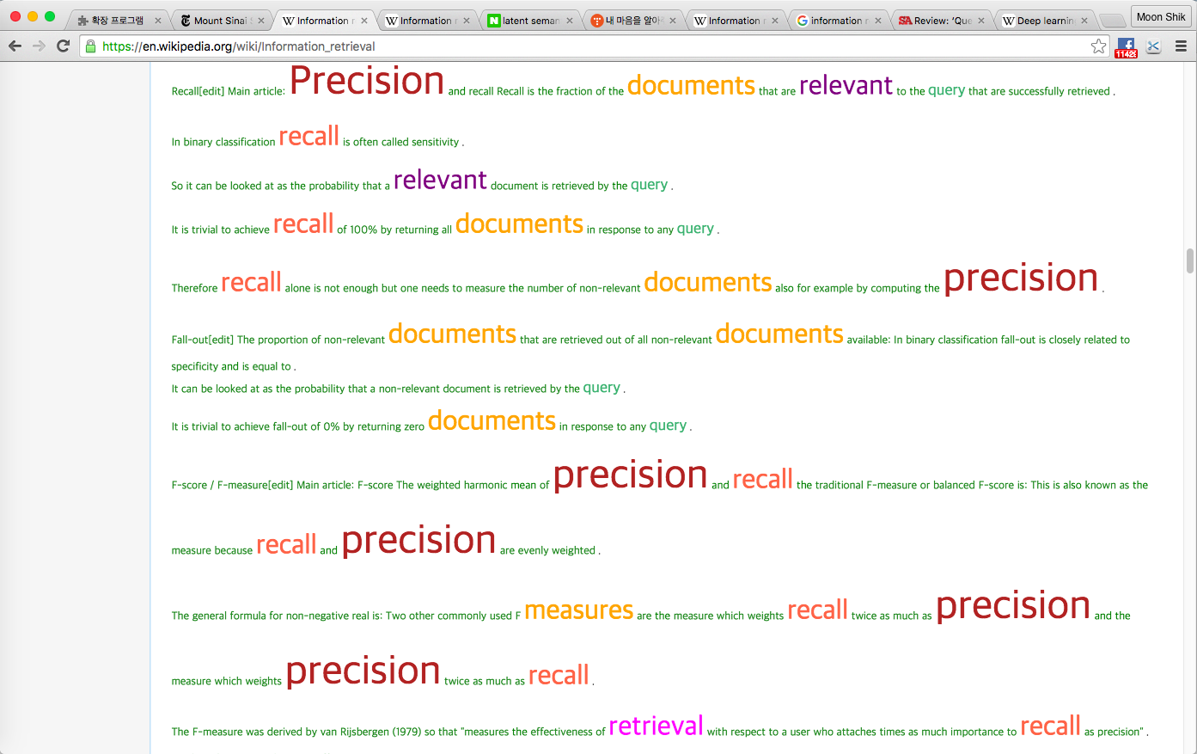
2. With tag weight(30,20,15)
141, precision
139, information
117, retrieval
61, model
56, average
52, recall
52, measures
49, documents
40, the
29, system
28, relevant
28, performance
26, visualization
25, mathematical
25, management
25, edit
25, gain
25, systems
25, overview
25, links
24, cumulative
24, history
24, discounted
23, reading
23, types
23, field
23, basis
23, references
23, query
23, external
23, properties
22, correctness
22, timeline
22, second
22, awards
22, software
22, computer
20, mean
20, and
20, also

Slide 31

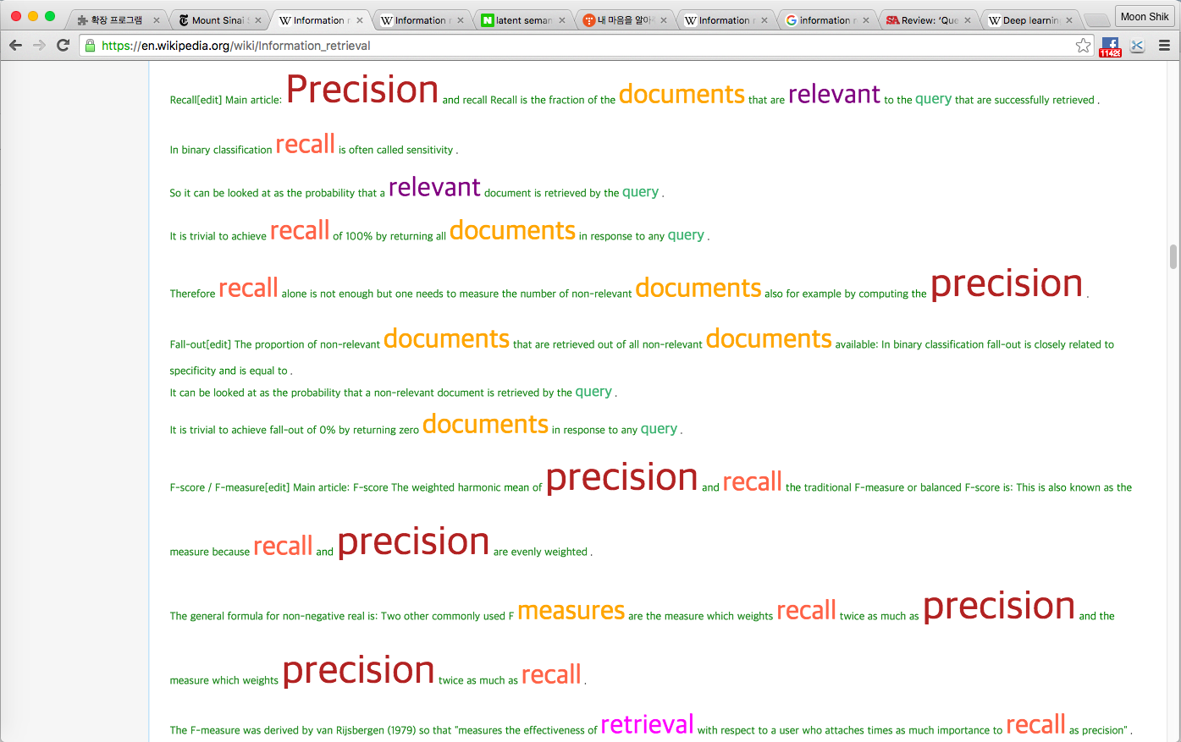
3. With tag weight(50,20,15)
159, information
141, precision
137, retrieval
61, model
56, average
52, recall
52, measures
49, documents
40, the
29, system
28, relevant
28, performance
26, visualization
25, mathematical
25, management
25, edit
25, gain
25, systems
25, overview
25, links
24, cumulative
24, history
24, discounted
23, reading
23, types
23, field
23, basis
23, references
23, query
23, external
23, properties
22, correctness
22, timeline
22, second
22, awards
22, software
22, computer
20, mean
20, and
20, also

Slide 32
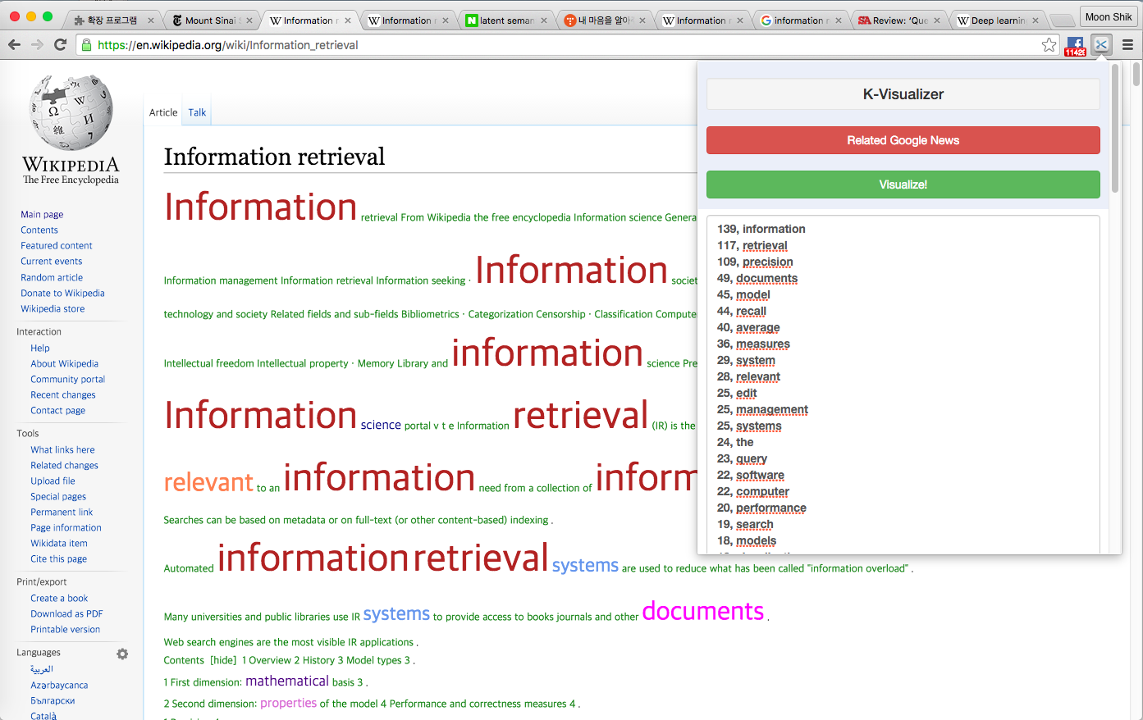
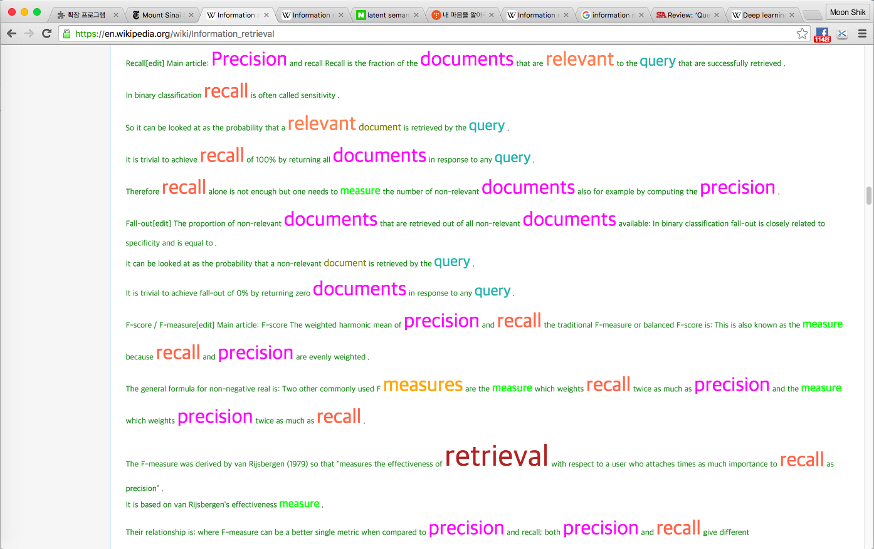
4. With tag weight(30,12,10)
139, information
117, retrieval
109, precision
49, documents
45, model
44, recall
40, average
36, measures
29, system
28, relevant
25, edit
25, management
25, systems
24, the
23, query
22, software
22, computer
20, performance
19, search
18, models
18, visualization
17, gain
17, mathematical
17, overview
17, links
16, measure
16, discounted
16, ext
16, history
16, document
16, cumulative
15, external
15, reading
15, references
15, field
15, science
15, properties
15, basis
15, types
15, data

Slide 33
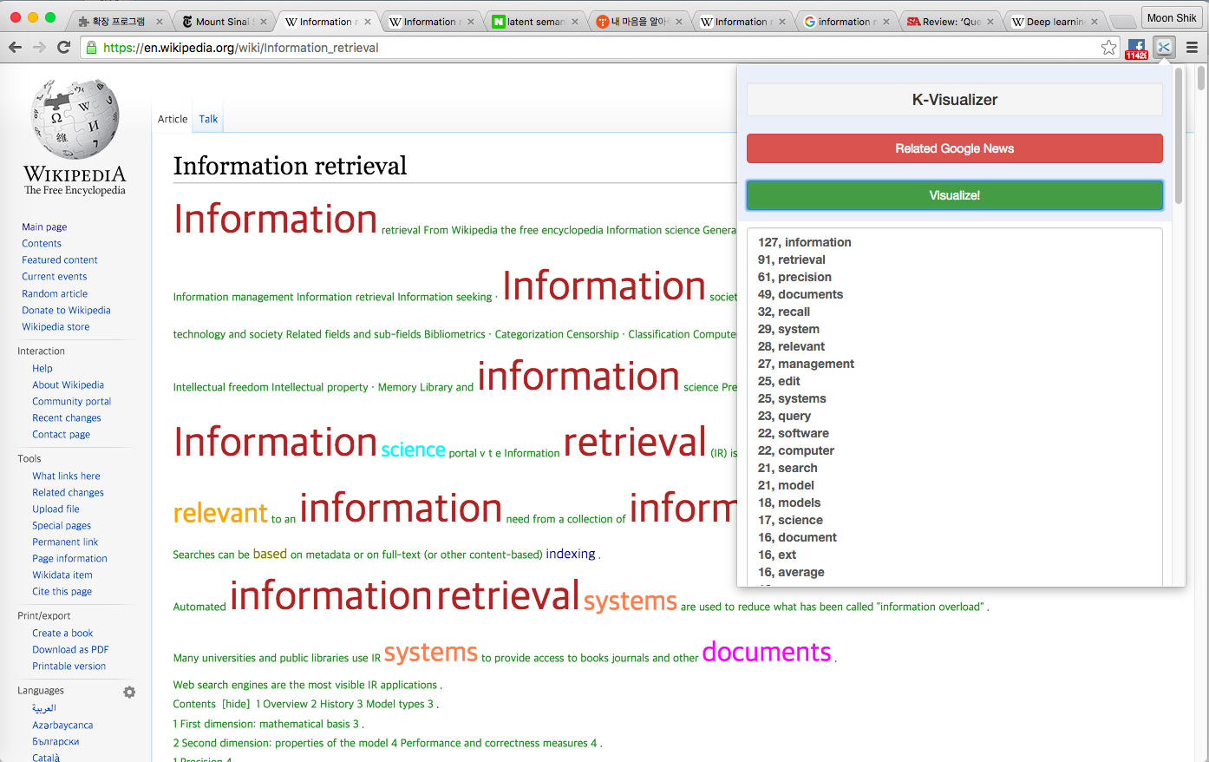
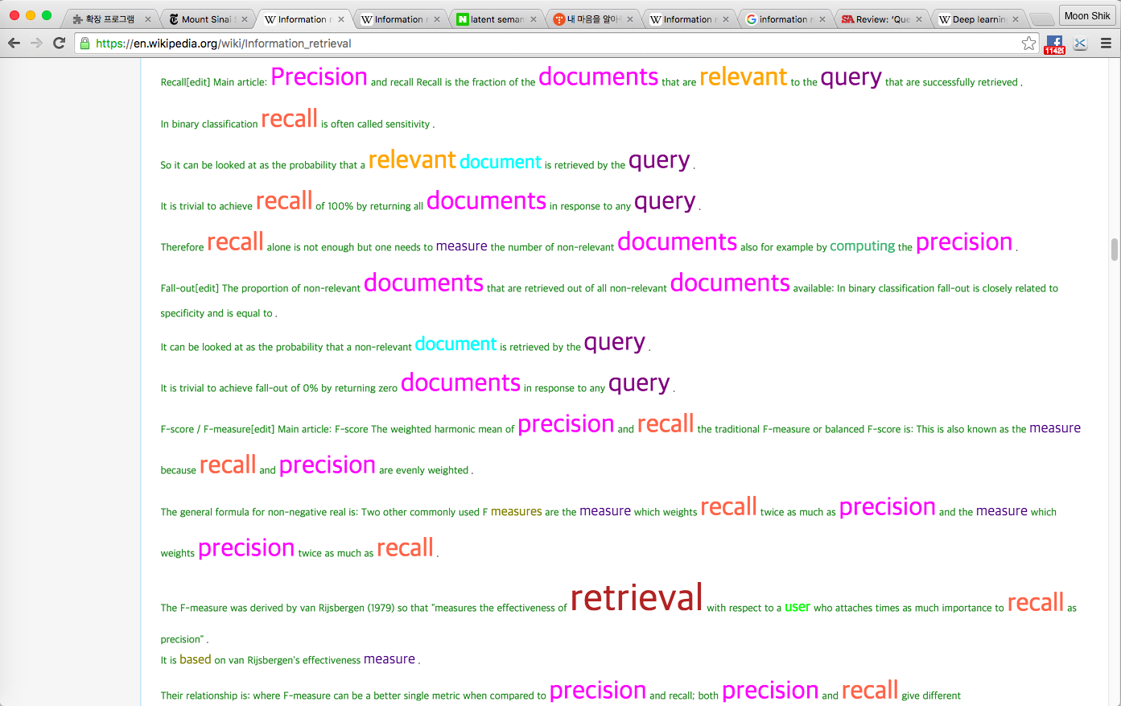
5. With distance weight(3)
127, information
91, retrieval
61, precision
49, documents
32, recall
29, system
28, relevant
27, management
25, edit
25, systems
23, query
22, software
22, computer
21, search
21, model
18, models
17, science
16, document
16, ext
16, average
16, measure
15, data
14, analysis
14, published
14, relevance
14, user
14, text
13, network
13, computing
13, evaluation
12, measures
12, based
11, conference
11, score
10, indexing
10, society
10, set
10, vector
9, terms
9, queries

Slide 34
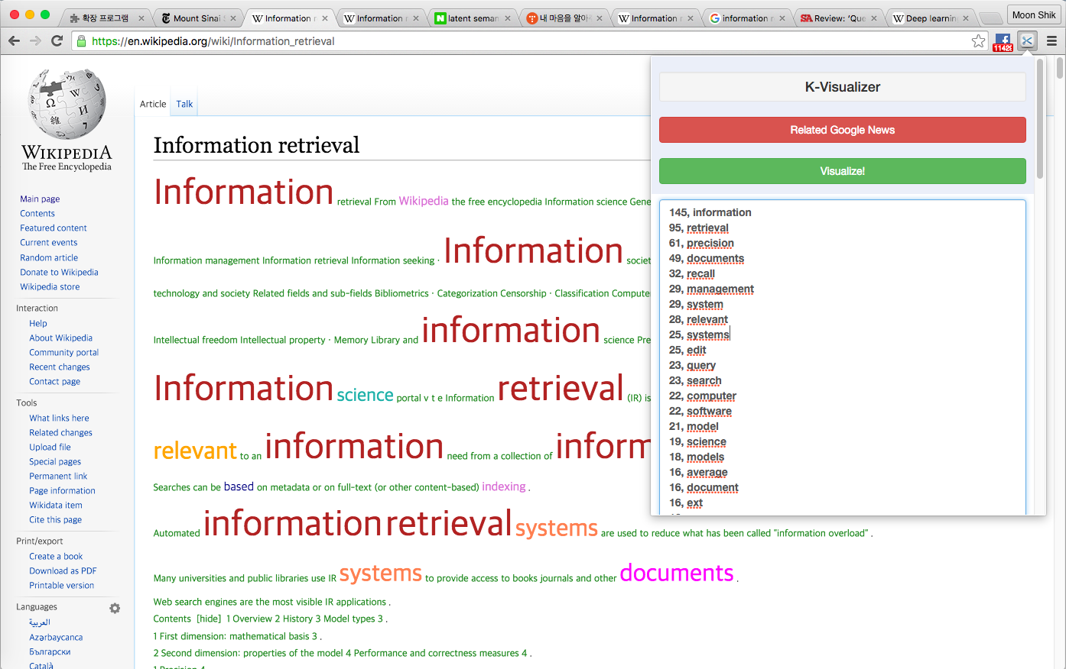
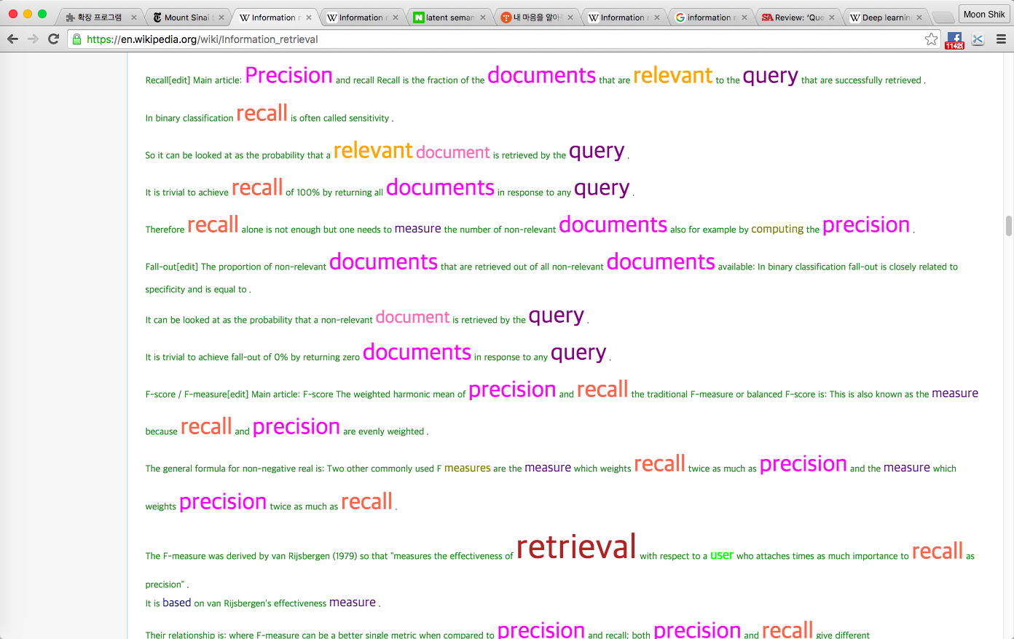
6. With distance weight(5)
145, information
95, retrieval
61, precision
49, documents
32, recall
29, management
29, system
28, relevant
25, systems
25, edit
23, query
23, search
22, computer
22, software
21, model
19, science
18, models
16, average
16, document
16, ext
16, measure
15, data
14, text
14, user
14, published
14, analysis
14, relevance
13, network
13, evaluation
13, computing
12, society
12, measures
12, based
11, score
11, conference
10, knowledge
10, set
10, vector
10, wikipedia
10, indexing

Slide 35

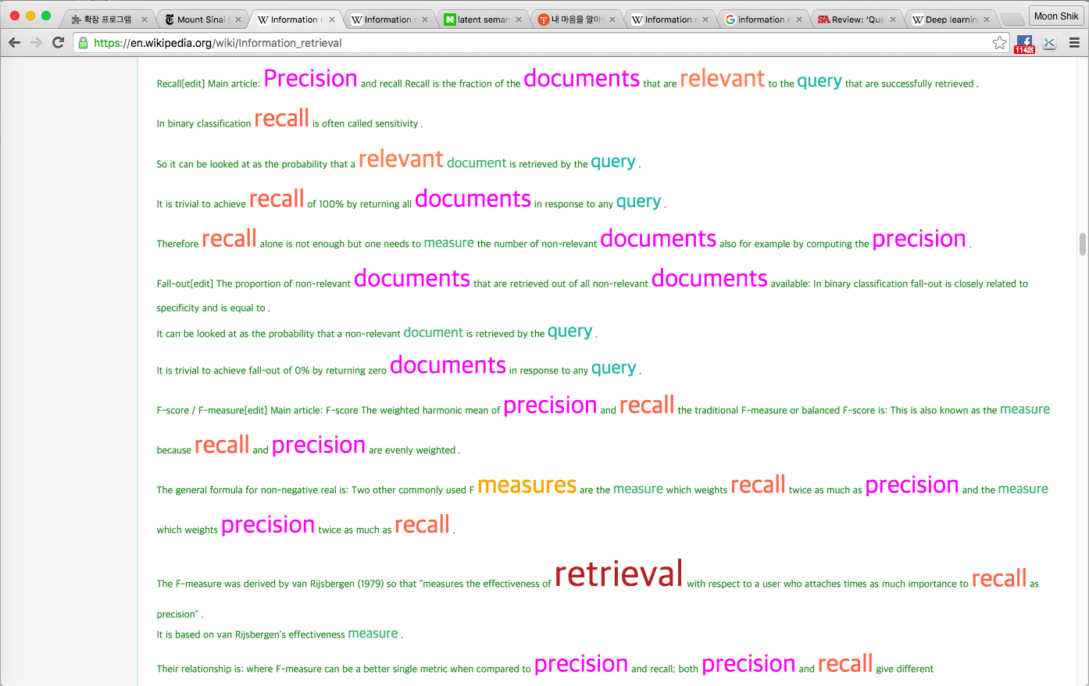
7. With tag and distance weight (30, 12, 10, 5, 3)
165, information
123, retrieval
109, precision
49, documents
45, model
44, recall
40, average
36, measures
29, system
28, relevant
27, management
25, systems
25, edit
24, the
23, query
23, search
22, software
22, computer
20, science
20, performance
18, models
18, visualization
17, overview
17, links
17, mathematical
17, gain
16, measure
16, cumulative
16, document
16, ext
16, discounted
16, history
15, reading
15, field
15, properties
15, basis
15, types
15, references
15, data
15, external

Slide 36
Analysis with AHP(Analytic Hierarchy Process)
(1) 가중치 산정 결과
 | Factor 01 | Factor 02 | Factor 03 | Factor 04 | Factor 05 | Factor 06 | Factor 07
Weight | 0.129 | 0.131 | 0.127 | 0.167 | 0.133 | 0.136 | 0.176
(2) 비교 행렬
 | Factor 01 | Factor 02 | Factor 03 | Factor 04 | Factor 05 | Factor 06 | Factor 07
Factor 01 | 1 | 0.802 | 1.213 | 0.711 | 0.899 | 1.139 | 0.702
Factor 02 | 1.246882793 | 1 | 0.918 | 0.759 | 0.942 | 1.049 | 0.669
Factor 03 | 0.824402308 | 1.089324619 | 1 | 0.847 | 0.91 | 0.857 | 0.787
Factor 04 | 1.406469761 | 1.317523057 | 1.180637544 | 1 | 1.299 | 1.176 | 0.961
Factor 05 | 1.112347052 | 1.061571125 | 1.098901099 | 0.769822941 | 1 | 0.882 | 0.752
Factor 06 | 0.877963126 | 0.953288847 | 1.166861144 | 0.850340136 | 1.133786848 | 1 | 0.806
Factor 07 | 1.424501425 | 1.494768311 | 1.27064803 | 1.040582726 | 1.329787234 | 1.240694789 | 1
Weight of Factor 07 is largest
tag and distance weight
increased satisfaction level

Slide 37
Best combination?
With Meta Tag And Distance Weighting
Without Meta Tag And Distance Weighting
Notes:
나타나지 않던 몇개의 주요 단어들이 나타난다.

Slide 38
Comparitive Result

Slide 39
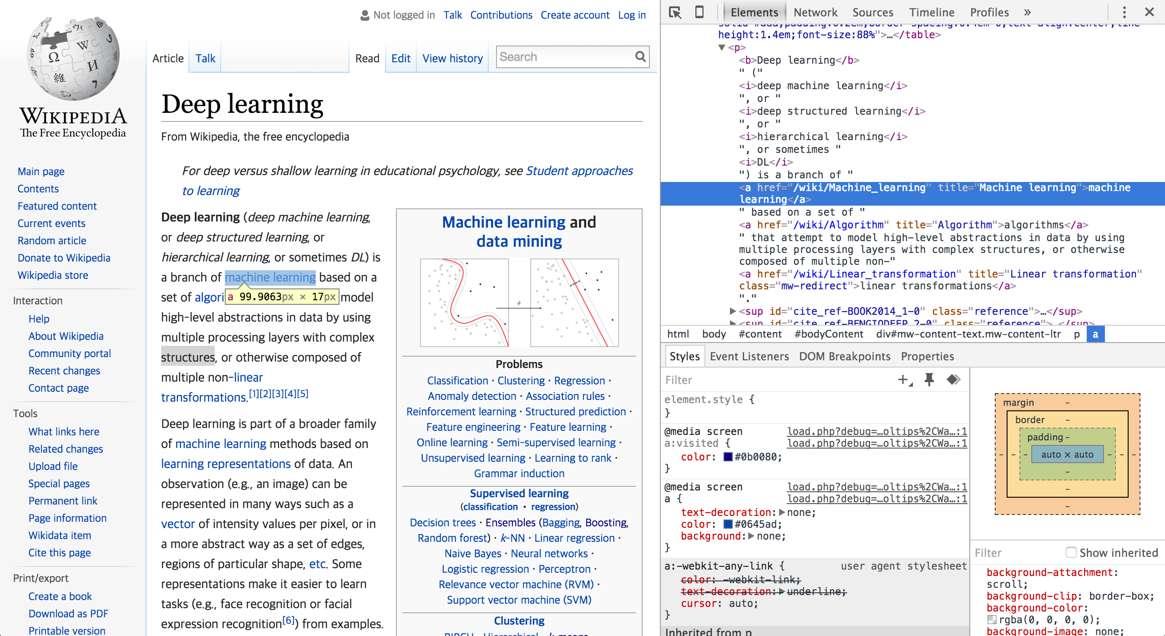
Wikipedia is ..

Slide 40
Future Works

Slide 41
Feature4 – Similarity Weighting
Weight based on ‘Ontology based Similarity score’
1) Extract words from innerText of <title>
2) Measure similarity score of selected
words with words in the text
3) Add weight on the words with
high similarity score

Slide 42
Thank you!

Slide 43
Reference
1. Ontology based Similarity Measure in Document Ranking
http://disi.unitn.it/~p2p/RelatedWork/Matching/pxc387774.pdf
2. Hypertext Categorization using Hyperlink Patterns and Meta Data
http://users.softlab.ntua.gr/facilities/public/AD/Text%20Categorization/ghani01hypertext.pdf
3. Mining “Hidden Phrase” Definitions from the Web
4. ‘Best Keyword Extraction Algorithms’ – Quora
https://www.quora.com/What-are-the-best-keyword-extraction-algorithms-for-natural-language-processing-and-how-can-they-be-implemented-in-Python
Notes:
그래서 우리는 좀더 비주얼 적이고 사용자가 사용하기 쉬운 키워드 찾기 툴을 고안해보고자 하였다.
Imaginational Simulation (not real)을 먼저 보자

Slide 44
Reference
5. Survey of keyword extraction techniques
http://www.cs.unm.edu/~pdevineni/papers/Lott.pdf
6. HTML tags as Extraction Cues for Web Page Description Construction
http://inform.nu/Articles/Vol6/v6p001-012.pdf?q=powerful-writing-in-30-words-or-less
Notes:
그래서 우리는 좀더 비주얼 적이고 사용자가 사용하기 쉬운 키워드 찾기 툴을 고안해보고자 하였다.
Imaginational Simulation (not real)을 먼저 보자

